Slide 1

Overview of the microalgae production process
Koenraad Muylaert

Slide 2
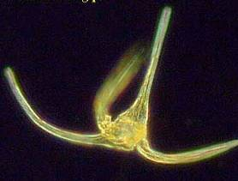
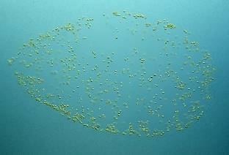
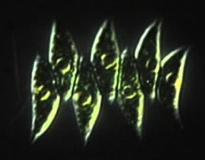
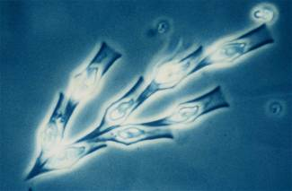
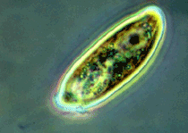
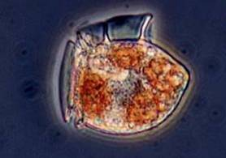
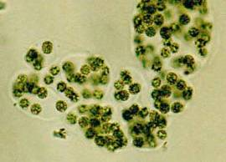
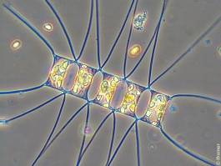
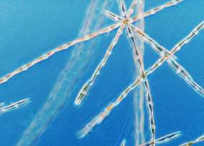
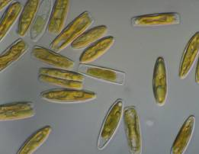
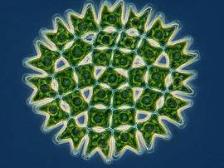
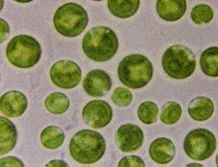
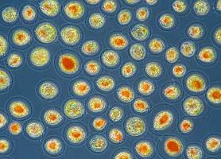
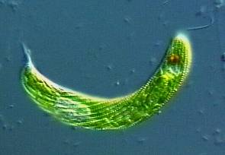
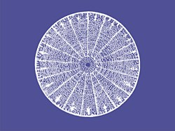
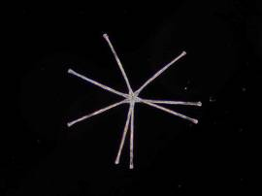
Notes:
We use biomass for a wide variety of plant species, but so far we almost exclusively use terrestrial plants. There Is also plants life in the oceans = microalgae, microscopic plants growing near the surface of our oceans and lakes. It’s important: about half of the biomass produced on this planet is produced by these microalgae. There is a wide diversity to choose from: they are a evolutionary old group, metabolic diversity is much higher than for land plants.

Slide 3
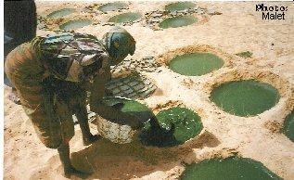
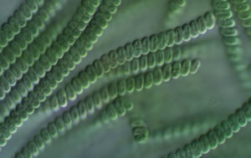
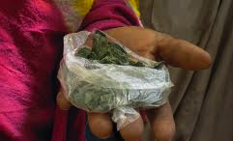
Historical use of microalgae (Spirulina, Tsjaad)

Slide 4
Photosynthesis
Conversion efficiency for solar to chemical energy:
Maximum efficiency of photosynthesis: 12%
  Belgium: 180 ton/ha/year
Short-term realised efficiency in experimental systems: 4%
  Belgium: 60 ton/ha/year
Long-term realised efficiency in commercial systems: 2%
  Belgium: 30 ton/ha/year

Slide 5
Productivity of microalgae
Soy
11 ton
Potato
17 ton
Wheat
18 ton
Corn
25 ton
Sugar beet
29 ton
Microalgae (practice)
35 ton
90 ton
Microalgae (lab)
Best practice annual production in ton dry biomass (leaves, stems, fruits) per hectare per year

Slide 6
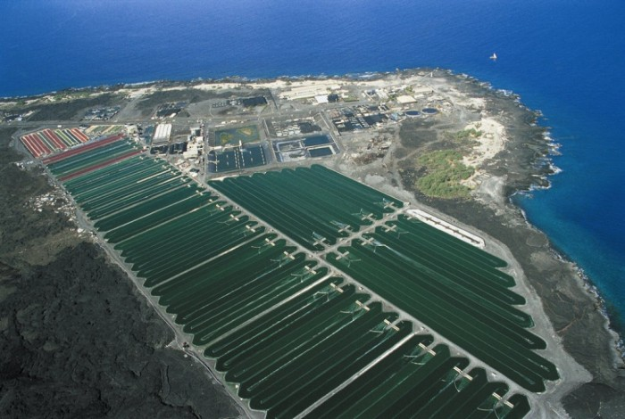

Slide 7
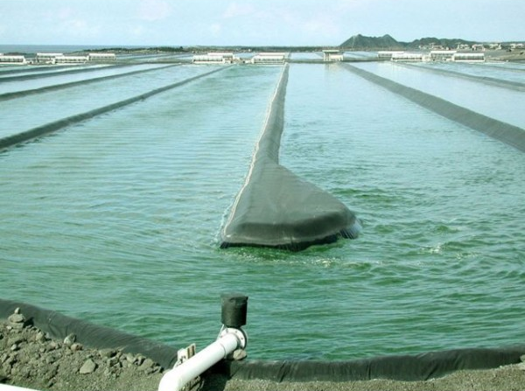
Production of Arthrospira in open ponds in Hawaii

Slide 8
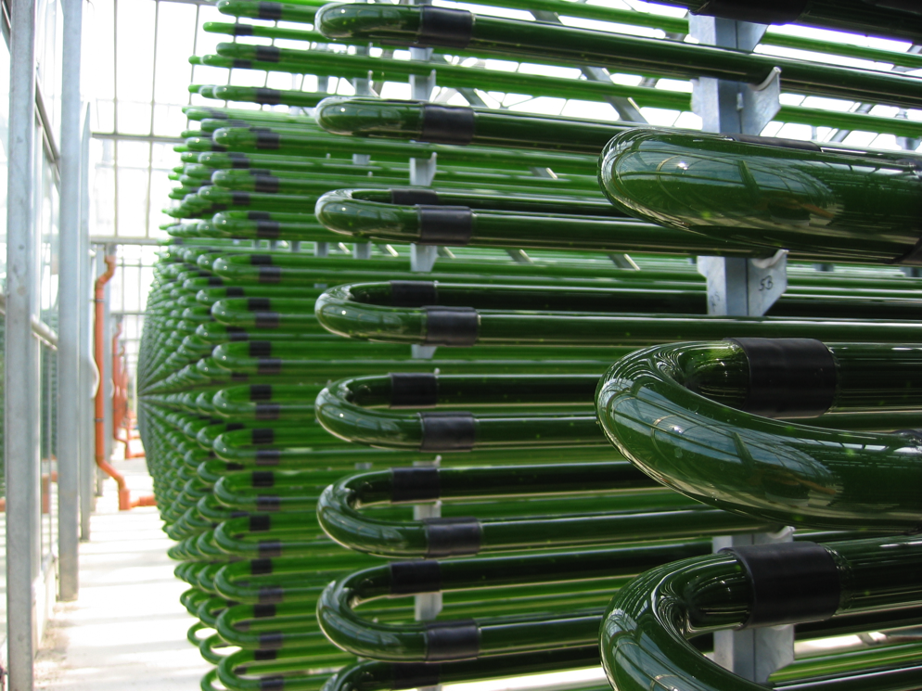
Production of Chlorella in a ‘photobioreactor’ in Germany

Slide 9
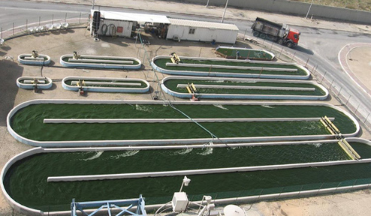
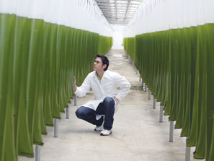
Cultivation of microalgae
Open systems (raceway ponds) Closed systems (photobioreactors)
Relatively cheap Expensive
Sensitive to contamination Resistant to contamination
Inefficient light use (respiration) Efficient light use
Low biomass concentration High biomass concentration
Experience in commercial systems Little experience on large scale

Slide 10
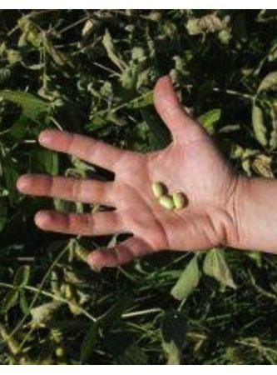
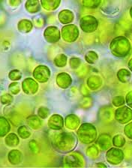
Biomass composition of microalgae
fibre
lipids
sugars
microalgae
soybean
protein

Slide 11
Biomass composition
proteins
proteins
NO₃⁻, NH₄⁺
sugars
lipids
CO₂

Slide 12
N supply and biomass composition
Growth under sufficient N supply
Amino acid synthesis
NO₃⁻
NH₄⁺
glutamine
light
é
PROTEINS
NADPH
ATP
Calvin
CO₂
glucose
H₂O
O₂
Photosynthetic light reactions
Photosynthetic dark reactions

Slide 13
N supply and biomass composition
Growth under N limitation
light
é
NADPH
ATP
Calvin
CO₂
glucose
starch/glycogen
H₂O
O₂
Photosynthetic light reactions
Photosynthetic dark reactions

Slide 14
Biomass composition
proteins
high N, low CO₂
proteins
sugars
lipids
low N, high CO₂

Slide 15
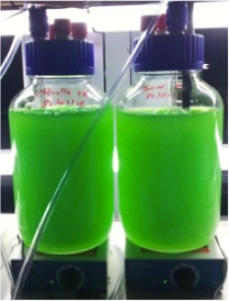
Harvesting microalgae
Challenges:
small cells: 5-10 µm diameter
low biomass concentration:
0.5 g dry matter L⁻¹
stable suspensions
-
-
-
-
-
-
-
-
-
-
-
-
-
-
-
-
-
-
-
-
Notes:
Cell suspnesions stabilized by negative surface charge of microalgae

Slide 16
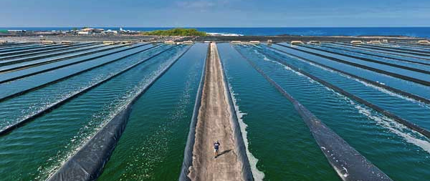
Harvesting microalgae
Challenge: low biomass concentration due to self-shading of cells (0.5 g dry weight L⁻¹)
assume 10 ha open pond facility with productivity of 350 ton year⁻¹
standing crop biomass is only 10 ton
facility should process 2000-3000 m³ day⁻¹ to harvest 350 ton

Slide 17
Wet biomass
drying and storage or processing of wet biomass?

Slide 18
Cell wall disruption
high pressure homogenisation
ultrasound
enzymatic process
…

Slide 19
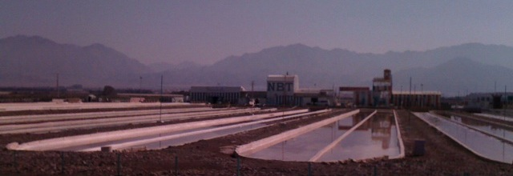



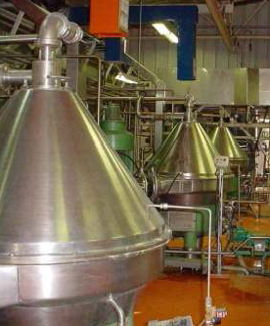
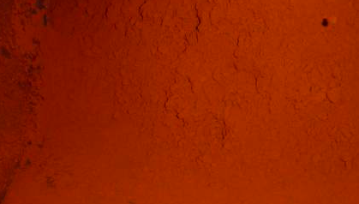
Notes:
Current production of microalgae for high-value products: technologies are too expensive for fuel production.

Slide 20
Energy balance
Energy output:
Energy content of biomass: 17.5 MJ/kg
Energy input:
Heat (drying of biomass): 13.7 MJ/kg
Electricity: 2.7 MJ/kg
Fertiliser: 3.4 MJ/kg
Infrastructure: 3.5 MJ/kg
Net energy balance: -5.8 MJ/kg
Lardon, L. et al. 2009 “Life-cycle assessment of biodiesel production from microalgae” Environmental Science & Technology 43: 6475-6481.

Slide 21

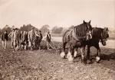

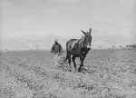


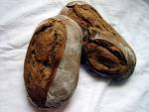


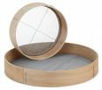













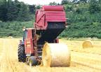
Need to optimise the production process
Notes:
Production process needs to be optimized, just as we did for conventional agriculture.

Slide 22
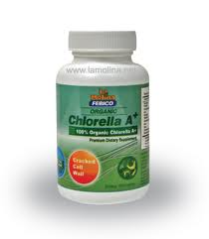
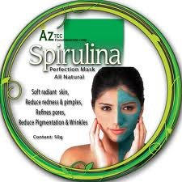
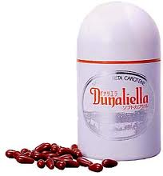
Current production and markets of microalgae
Total production 10 000 ton/year, market value 1 billion $/year,
nutritional supplements, cosmetics, natural pigments (25 – 300 $/kg)

Slide 23
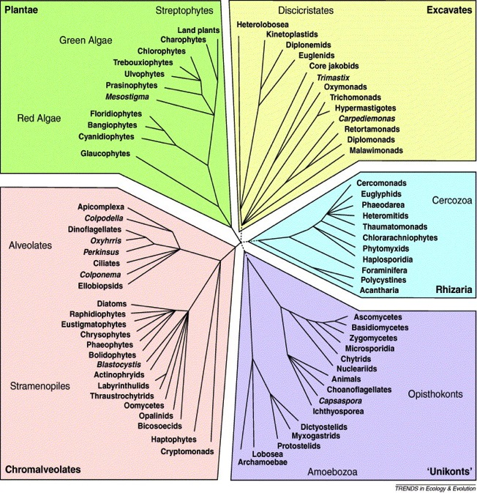
Unique bioproducts
0
lipids/fatty acids
pigments
polysaccharides, sugars

Slide 24
Natural pigments

Slide 25
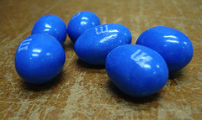
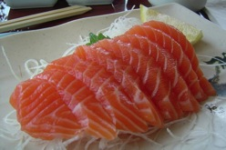
Processed products
phycocyanin: blue food colourant
astaxanthin: additive in salmon feed
emerging application: long-chain polyunsaturated fatty acids (EPA, DHA)

Slide 26
Conclusion
high productivity + attractive biomass composition = promising new biomass feedstock
complex production process = high cost of biomass
cost reduction required in all steps of production process to become competitive with conventional biomass feedstocks
microalgae as source of chemicals:
  low cost / high volume building blocks: scale increase and cost reduction required
  specialty chemicals, additives: perhaps, but no silver bullet…

Slide 27
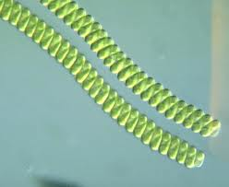
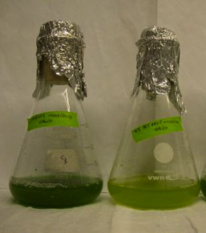
ALPO: Sara Cuellar
carbohydrate accumulation in Arthrospira induced by N stress: changes in metabolism (photosynthesis, metabolic pathways)
harvesting of Arthrospira by screening

Slide 28
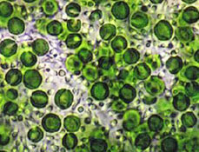
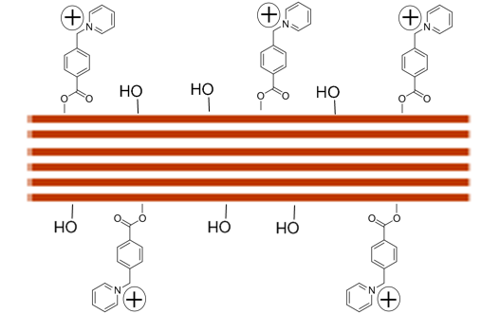
ALPO: An Verfaillie
use of cationic nanocellulose crystals for harvesting and cell disruption in Chlorella
preparation of nanocellulose crystals from waste biomass

